Slide 1
B&NES Local Plan - Somersetshire Coal Canal
Resident Meeting
March 2025

Slide 2
Agenda
No. | Item
1 | Meeting start Welcomes/ introductions Local Plan Brief update
2 | Somersetshire Coal Canal Society introductions - aspirations
3 | Local Plan Options spring consultation comments
4 | Proposed Policy Approach (Protection of the route)
5 | Option for consultation (Restoration/ Creation) Draft policy wording
6 | When is planning permission required?
7 | Next Steps
8 | AOB – questions

Slide 3
1. Introduction
Notes:
Would appreciate holding questions towards the end of the presentation.
Meeting is until 7pm we have commitments after this time as such we are unable to carry on past this time – Should there be more questions if you are able to contact me directly, I will be able to follow up after the meeting.
My email address and contact details were attached to the meeting invite sent out.
Noted that I will email a copy of the presentation out to attendees.

Slide 4
Local Plan Update
In summer 2024 the government published proposed changes to the National Planning Policy Framework (NPPF), revised standard method housing figures for each local authority and other changes to the planning system for consultation. Housing figures have been revised: 104% increase for B&NES from around 14,000 to about 29,000 homes over the plan period. Therefore, in September 2024 the Council's Cabinet took the decision to reset the Local Plan.
Resetting the Local Plan means the programme for its preparation has changed from that set out spring 2024. The revised programme has resulted in the need to hold another options consultation (Regulation 18) later this year before moving towards the Draft Local Plan stage (Regulation 19).
Current stage – Options stage (Regulation 18 consultation) - The purpose of this stage is to engage with residents and relevant organisations to identify how planning policy can be used positively to help address key issues within the local authority area. It takes any issues that have been highlighted and identifies the preferred approach for addressing these through planning policy.
Notes:
Town and country planning Act (Regulation 18 and 19)

Slide 5
2. Somersetshire Coal Canal Society introductions - Aspirations

Slide 7
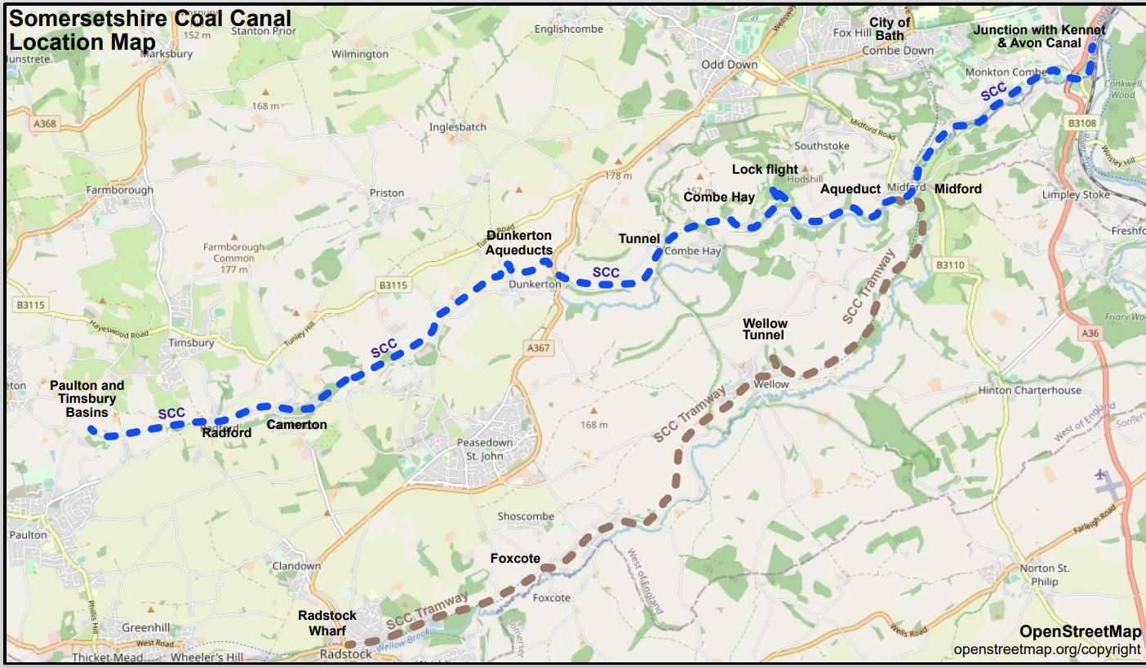

Slide 8
Conclusion of Somersetshire Coal Canal Society recent statement
It should be stressed that the Society’s intention in engaging with the Local Plan process is to protect the route of the Somersetshire Coal Canal so that restoration to water remains a viable possibility. The Local Plan does not grant permission to engage in restoration itself.
Restoration is a long-term project which will rely upon the agreement of individual landowners to work upon their land, at which time detailed construction plans will be drawn up for consideration as part of the normal planning process.
Restoration of the route to water will bring with it benefits in biodiversity, public wellbeing and leisure opportunities. Experience of similar schemes also shows significant financial benefits to landowners and householders in the area of the restoration.

Slide 9
3. Local Plan Options Consultation Comments

Slide 10
Questions asked during the consultation
Question 1:
Encouraging enhancements for heritage assets - Should we re-word Policy HE2 to also encourage development or improvements which would sustain or enhance, or better reveal, the significance of the Wansdyke or Somersetshire Coal Canal?
Question 2:
Proposed expansions to support restoration of the Somersetshire Coal Canal - Do you agree with our proposed expansions to the Somersetshire Coal Canal route? Are the proposals indicated in the maps (Figures 66 to 70) effective and justified, in your opinion? Please give reasons for your answers.
Notes:
Comments were divided in support and objection for the amendments.
Noted that comments in support cited protection of the heritage asset and benefits of maintaining or restoring the route. Comments in objection primarily cited residential amenity concerns and any restoration impacts which may cause harm to biodiversity.
Although not specifically a planning policy matter objections with regards to property value had also been raised.

Slide 11
4. Proposed Policy Approach (Protection of the route)

Slide 12
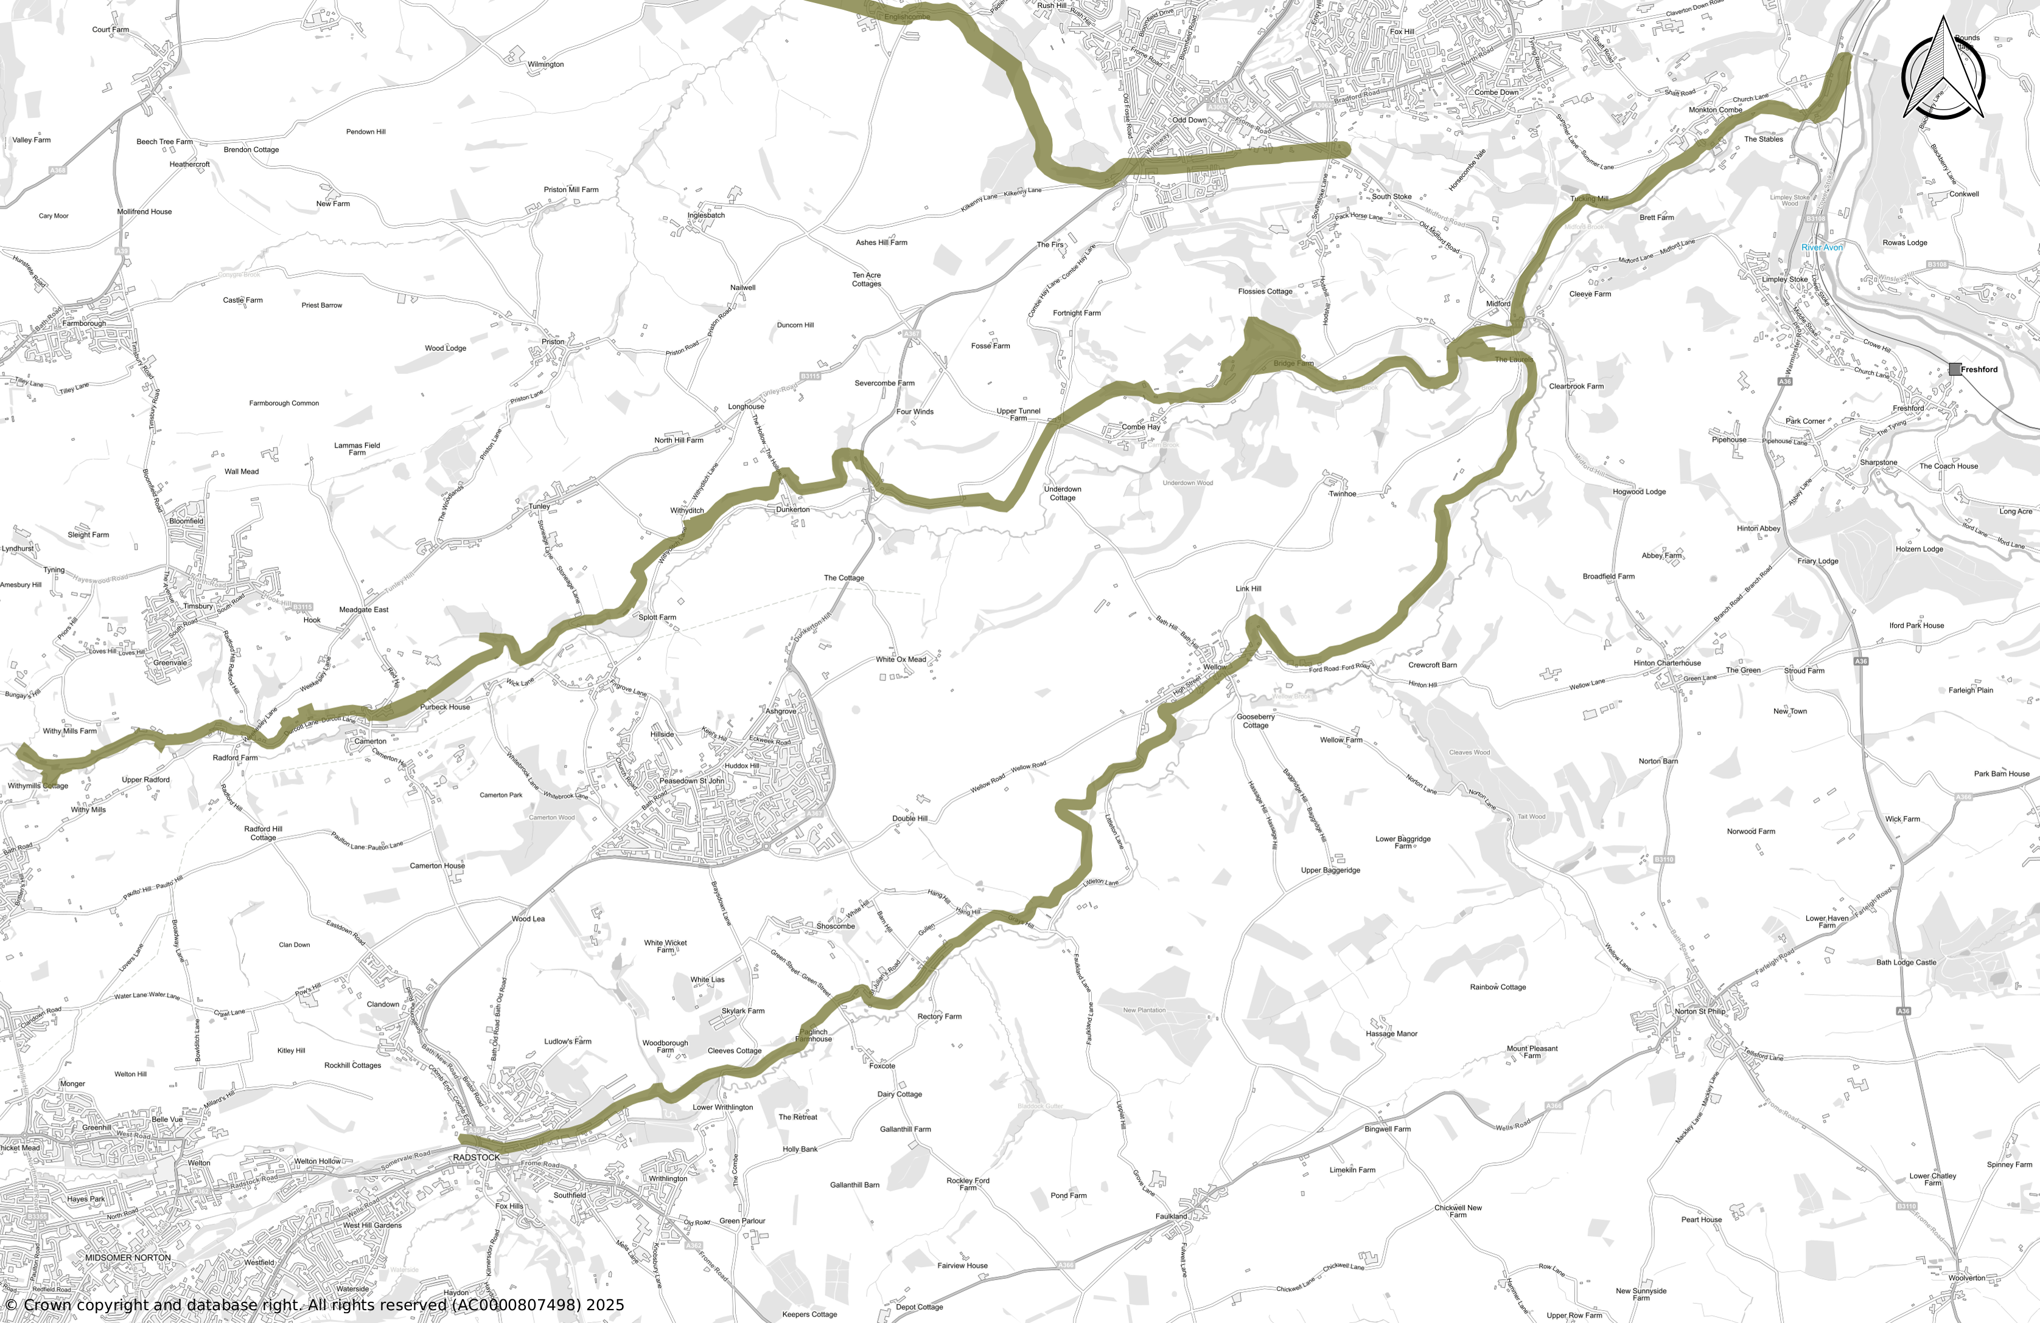
Existing Somersetshire Coal Canal route
Notes:
In line with the NPPF, policy HE2 is required to ensure there is a positive strategy to ensure the Somersetshire Coal Canal which is a heritage asset can be conserved and enjoyed.
Proposed Policy Approach (Protection of the route) - Retain the existing policy, and the protected route shown on the policies map.
Explanation - The proposed approach is effectively retaining the existing Placemaking Plan policy that protects the existing route/heritage asset from other development that would require planning permission. Important to note that the Council is of the view that we should continue to protect the heritage asset. This is because such an approach is in line with the NPPF.

Slide 13
5. Option for consultation (Restoration/ Creation) – Draft Policy Wording

Slide 14
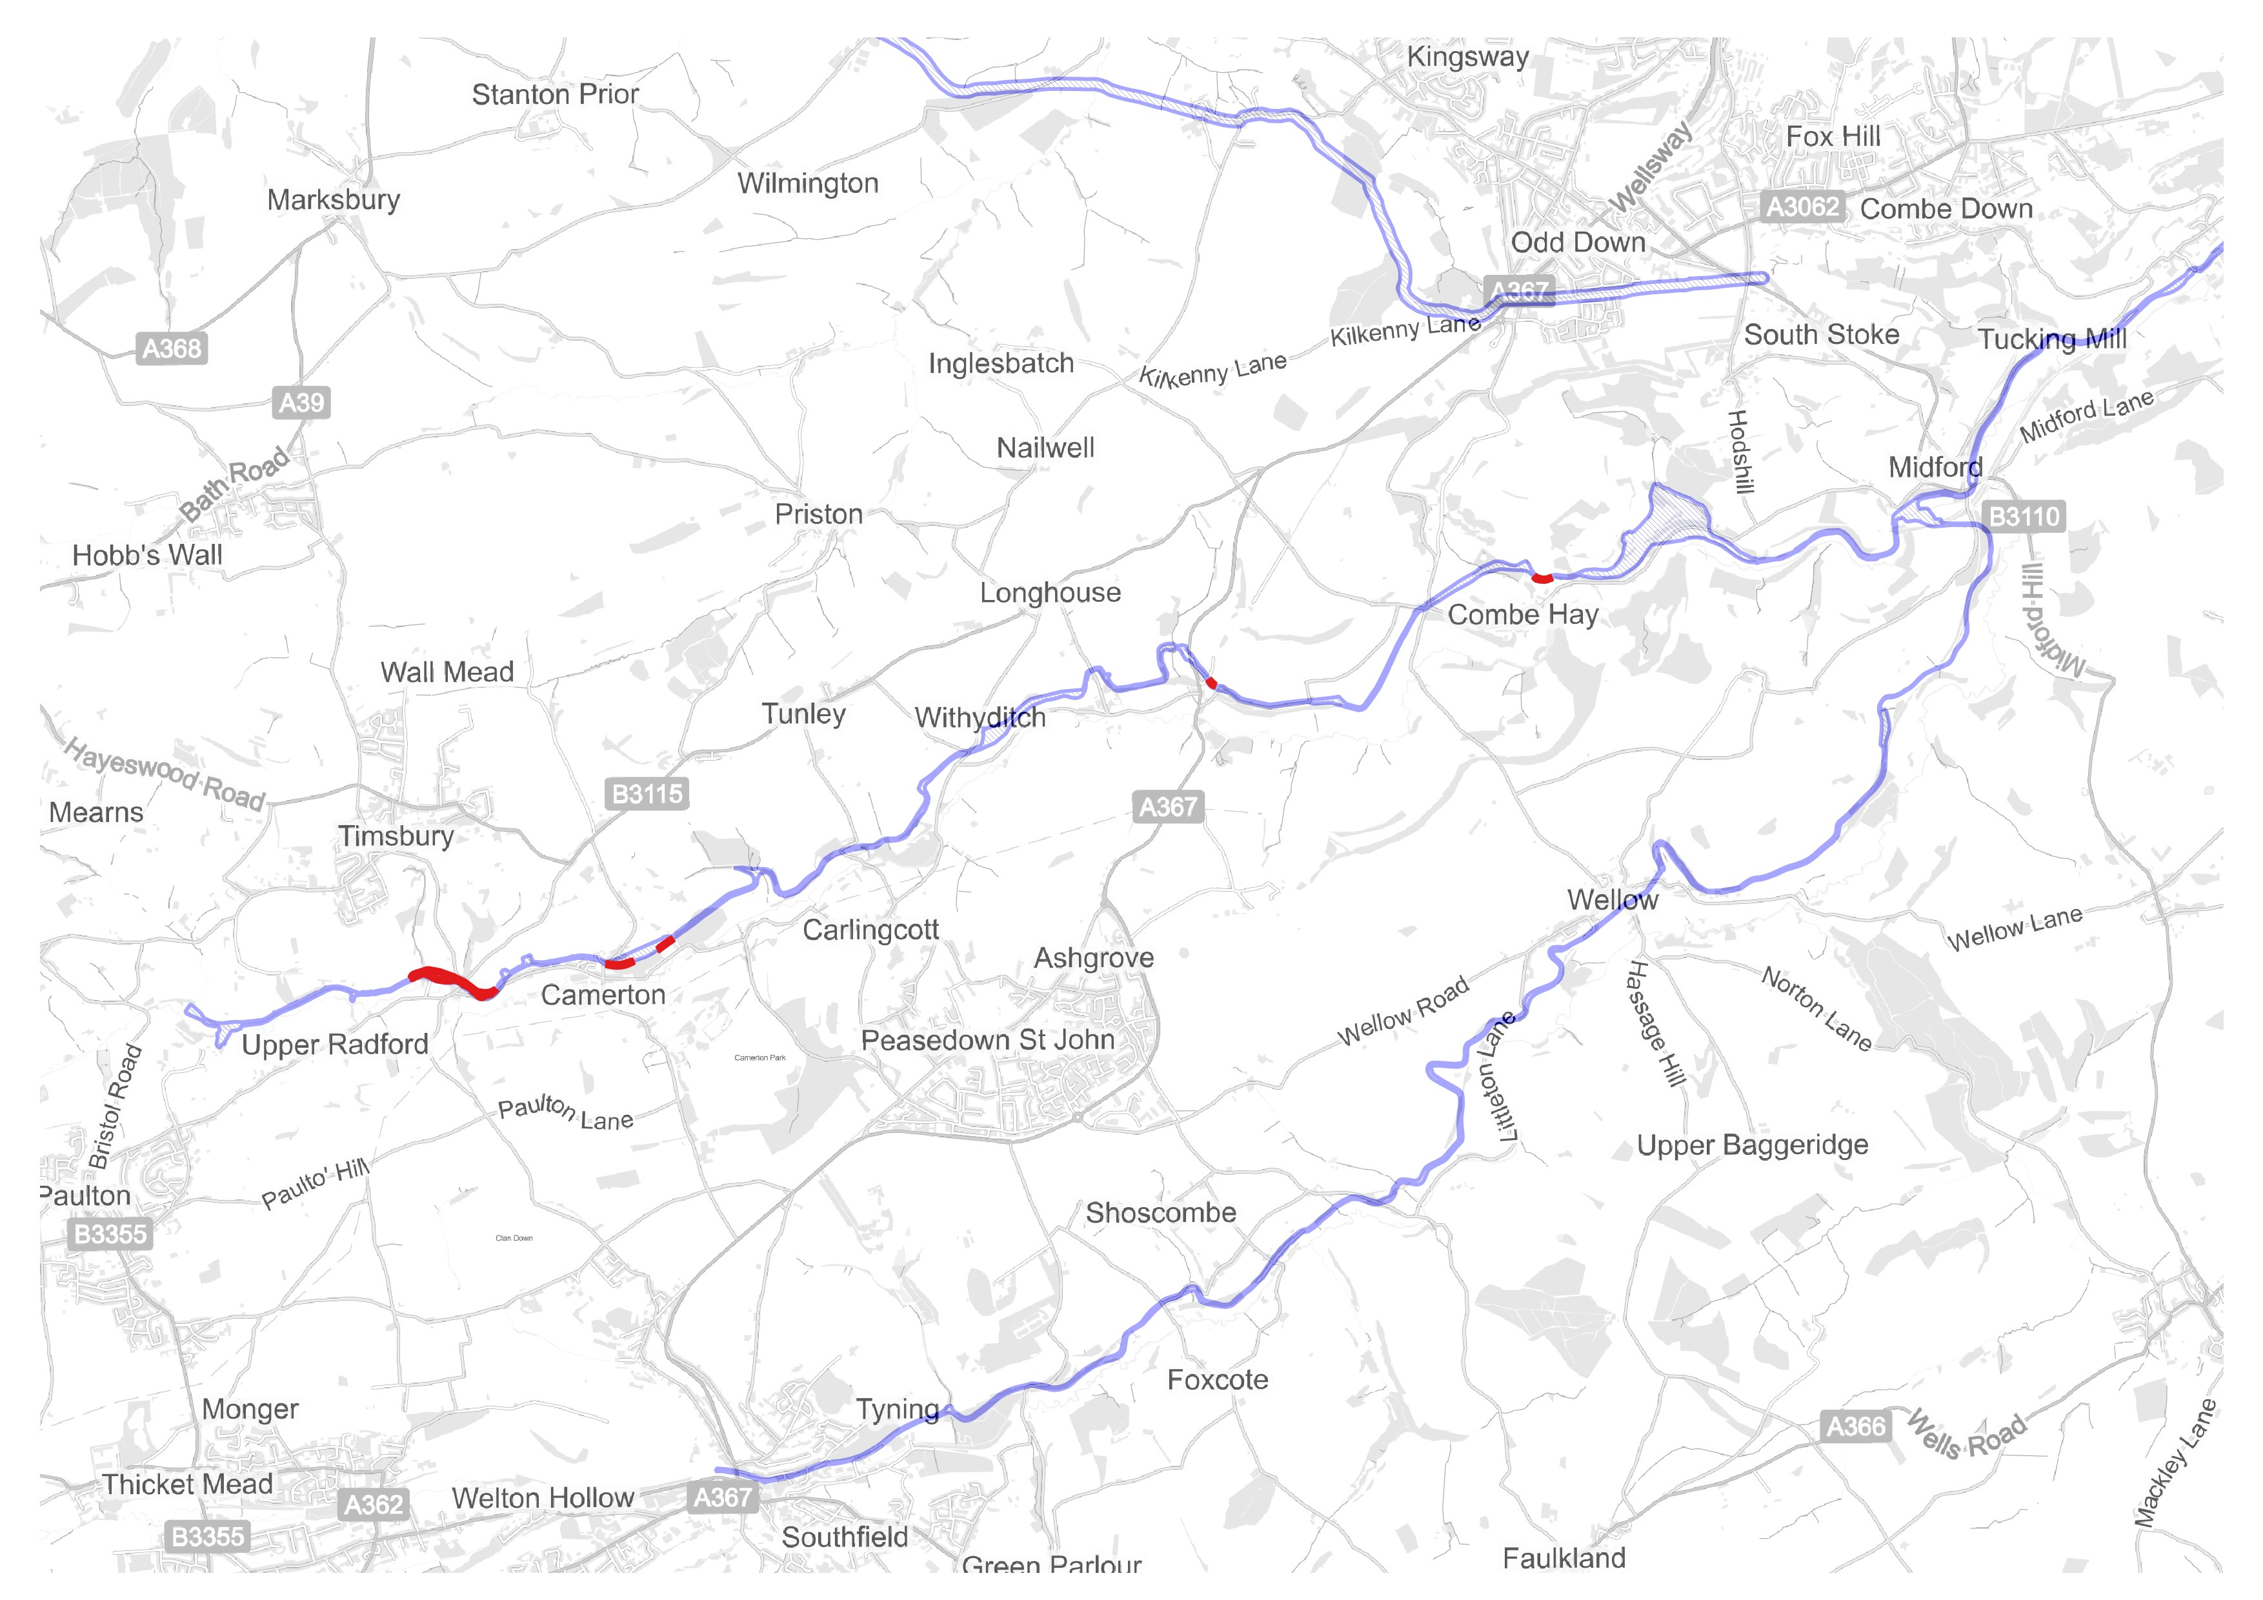
Routes highlighted for diversion
Existing Somersetshire Coal Canal designation (with blue outline)
Option for route diversion as consulted on in the spring (with red outline)
Notes:
Following on from the spring 2024 options consultation we are now proposing splitting the policy approach into a proposed protection policy and options around restoration/diversion.

Slide 15
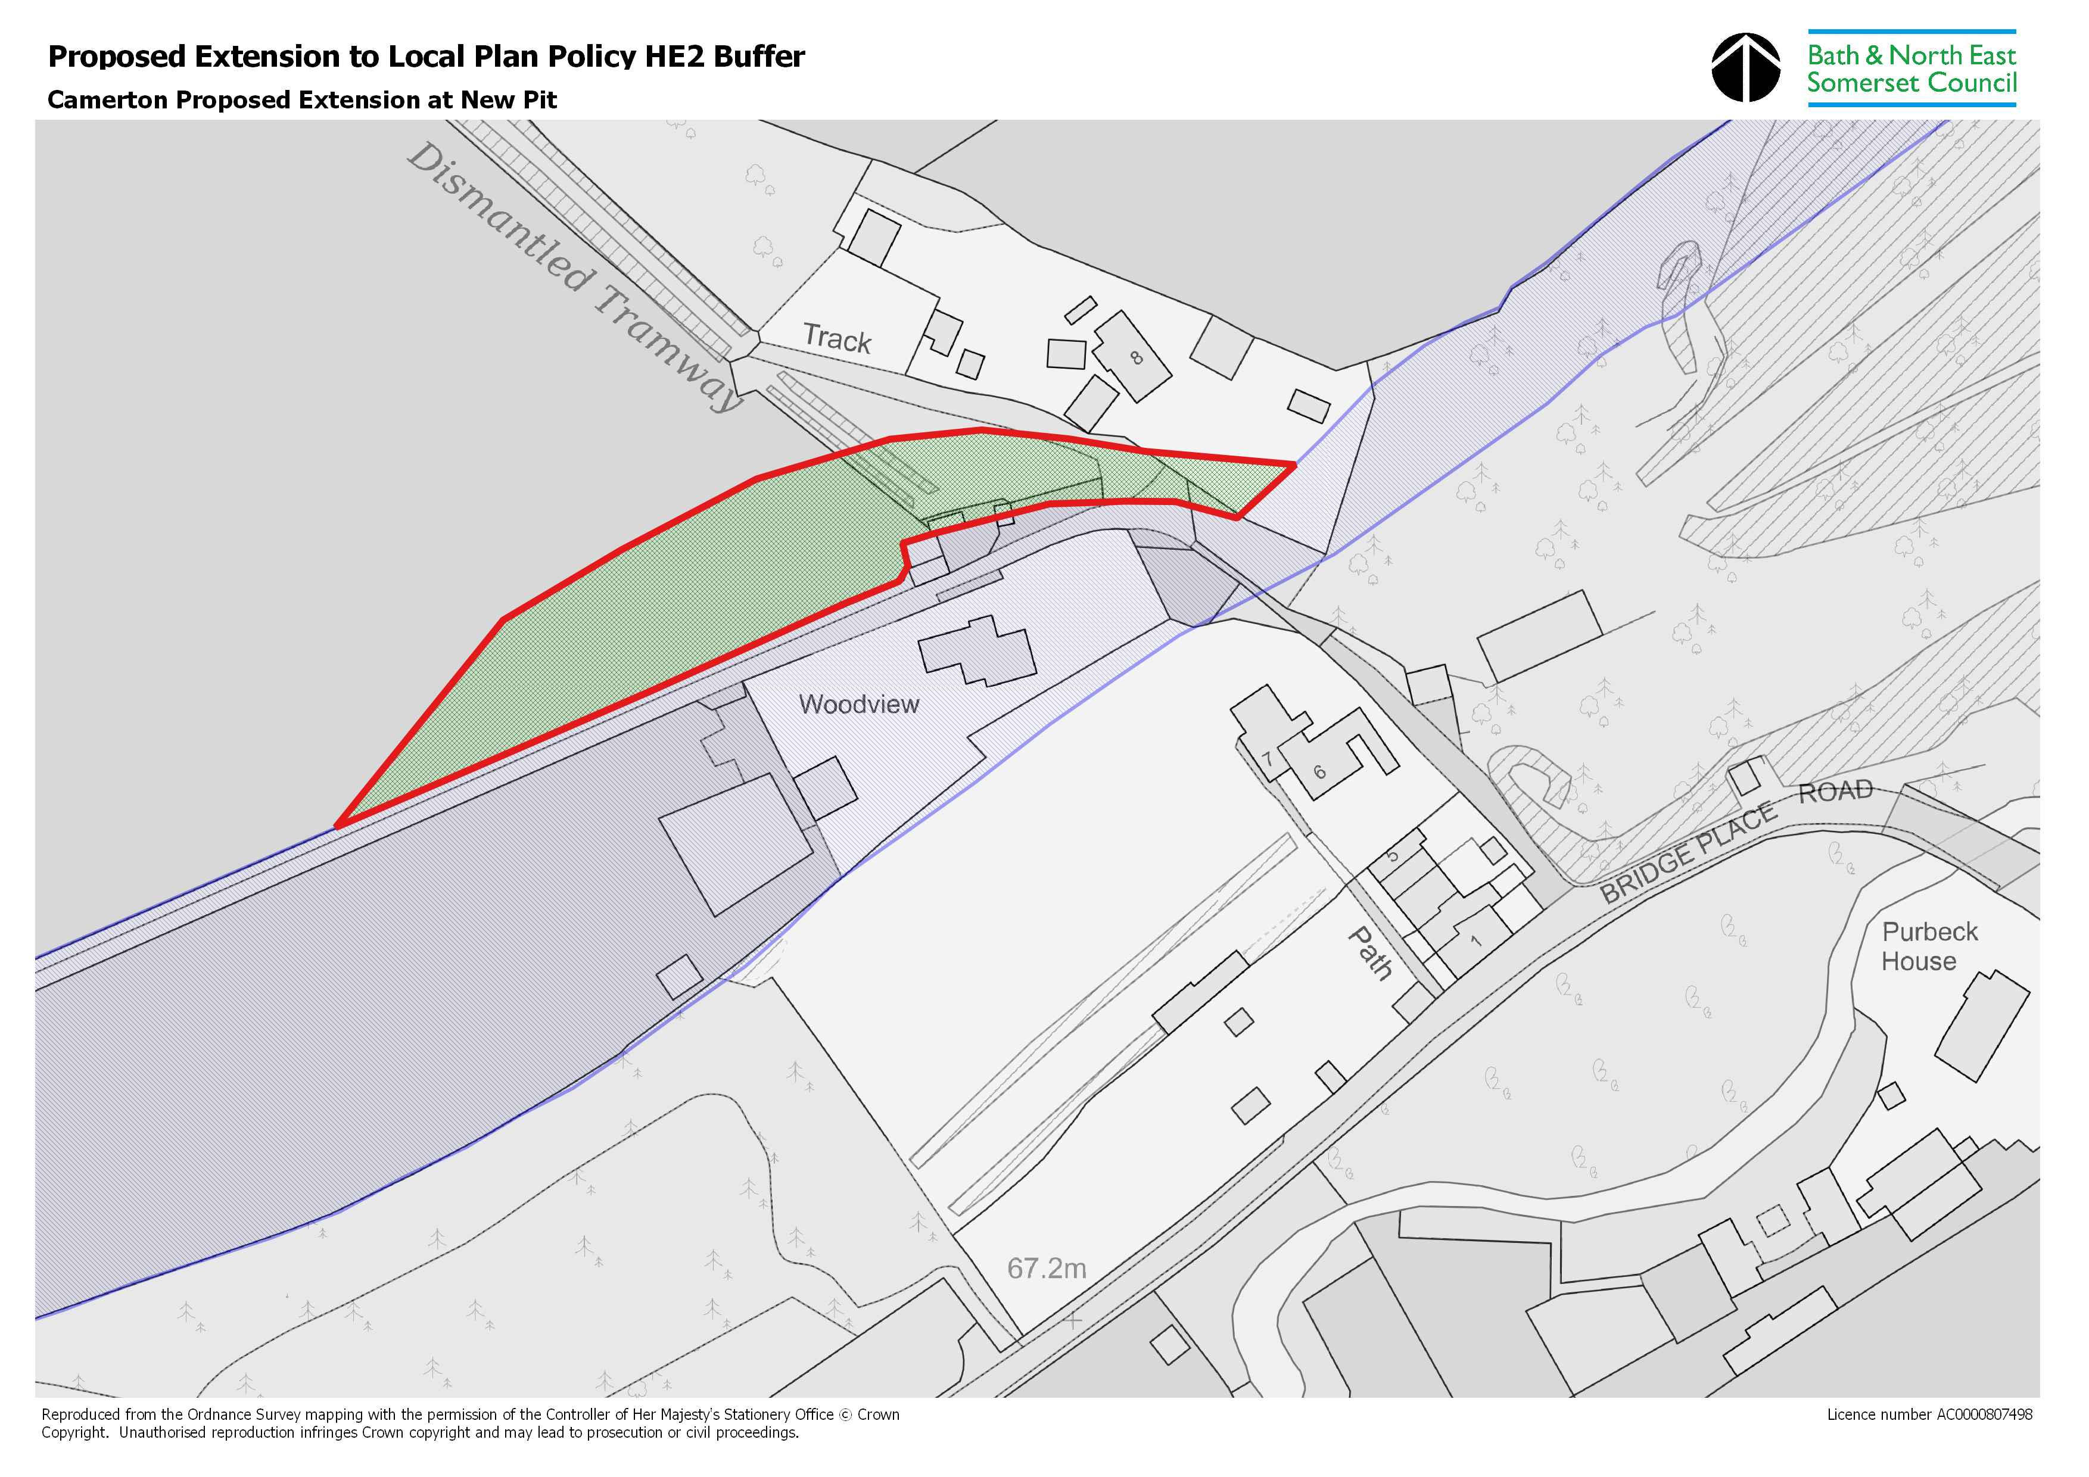
Restoration/ Creation
Option for route diversion as consulted on in the spring (with red outline)
Approach outlined for removal of residential curtilage draft example (outlined purple)
Existing Somersetshire Coal Canal designation (with blue outline)
Notes:
Option for consultation (Restoration/ Creation) - Development of a separate policy option which seeks restoration/ creation of a diverted route. This is to take account of elements of the existing route which has been lost to development and consider the deletion of said elements. This option would require the exploration of areas of the route which has been lost to development, and removing said elements of the route displayed on the policies map. For example, built form and some areas of residential/ building curtilage. It will need to be ensured elements of the route not considered built form or immediate curtilage remain within the buffer. Any deleted element of the existing route would be replaced by a diverted route.

Slide 16
Draft Policy Wording
Development seeking to amend/ restore elements of the Somersetshire Coal Canal must consider and seek to achieve, in line with the provisions set out under policy HE1:
the desirability of sustaining and enhancing the significance of the Somersetshire Coal Canal, and ensuring its viable use is consistent with its conservation;
the wider social, cultural, economic and environmental benefits that conservation of the historic environment can bring;
the desirability of new development making a positive contribution to local character and distinctiveness;
Any projects/works associated with the Somersetshire Coal Canal are required to consider the amenity of residents and or landowners. In particular restoration works must secure and demonstrate the agreement of landowners before any works take place. Any developments must ensure they do not increase current or future flood risk.
Notes:
The option will require a caveat to the policy and supporting text to ensure any restoration considers the amenity of residents and or landowners. Restoration works requiring agreement of landowners before any works take place. Any developments to ensure they do not increase current or future flood risk (in line with Environmental Agency Comments). Ensuring restoration does not harm the heritage asset.
Explanation - Optional policy on restoration only applies to activities that require planning permission. It should be noted that this element is proposed to be consulted on as an option.

Slide 17
6. When is permission required

Slide 18
Defining Development
Planning permission is only needed if the work being carried out meets the statutory definition of ‘development’ which is set out in section 55 of the Town and Country Planning Act 1990.
‘Development’ includes amongst other things:
building operations (eg structural alterations, construction, rebuilding, most demolition);
material changes of use of land and buildings;
engineering operations (eg groundworks);
What if there are restrictions through deeds or covenants that prevent development?
Land ownership, including any restrictions that may be associated with land, is not a planning matter. An appropriate legal professional will be able to provide further advice on this if necessary.
Source Planning Practice Guidance Paragraph: 005 Reference ID: 13-005-20140306

Slide 19
Permitted Development
Development does not in all instances require a planning application to be made for permission to carry out the development. In some cases, development will be permitted under national permitted development rights.
Permitted development rights allow householders to improve and extend their homes without the need to apply for planning permission which, are subject to assessment against local and national planning policy.
To receive a formal confirmation of whether certain forms of development fall under national permitted development rights an application for a certificate of lawful development can be submitted to the local planning authority.

Slide 20
7. Next Steps

Slide 21
Local Plan: Emerging Revised Programme
Options consultation
Draft Plan consultation
Examination/
Inspector’s Report
Adoption
Jun Jul Aug Sep Oct Nov Dec Jan Feb Mar Apr May Jun Jul Aug Sep Oct Nov Dec Jan Feb Mar Apr May Jun
2025 2026 2027
Notes:
Options stage (Regulation 18) - Further options consultation due to take place this autumn and the further opportunity this provides for residents/stakeholders to comment prior to moving towards the Draft Local Plan in spring 2026.
Draft Plan Stage (Regulation 19) - Publication of the local plan – The process allows local people and other key stakeholders to make comments on the new Local Plan for Bath and North East Somerset.
Following the publication of the draft plan, the council will review and consider all provided comments. The Local Plan - and all the representations made - will then be submitted to the Secretary of State for public examination by a Planning Inspector. There will be a further opportunity to make comments/ representations at the public examination stage.

Slide 22
8. Any other Business - Questions

